Slide 1
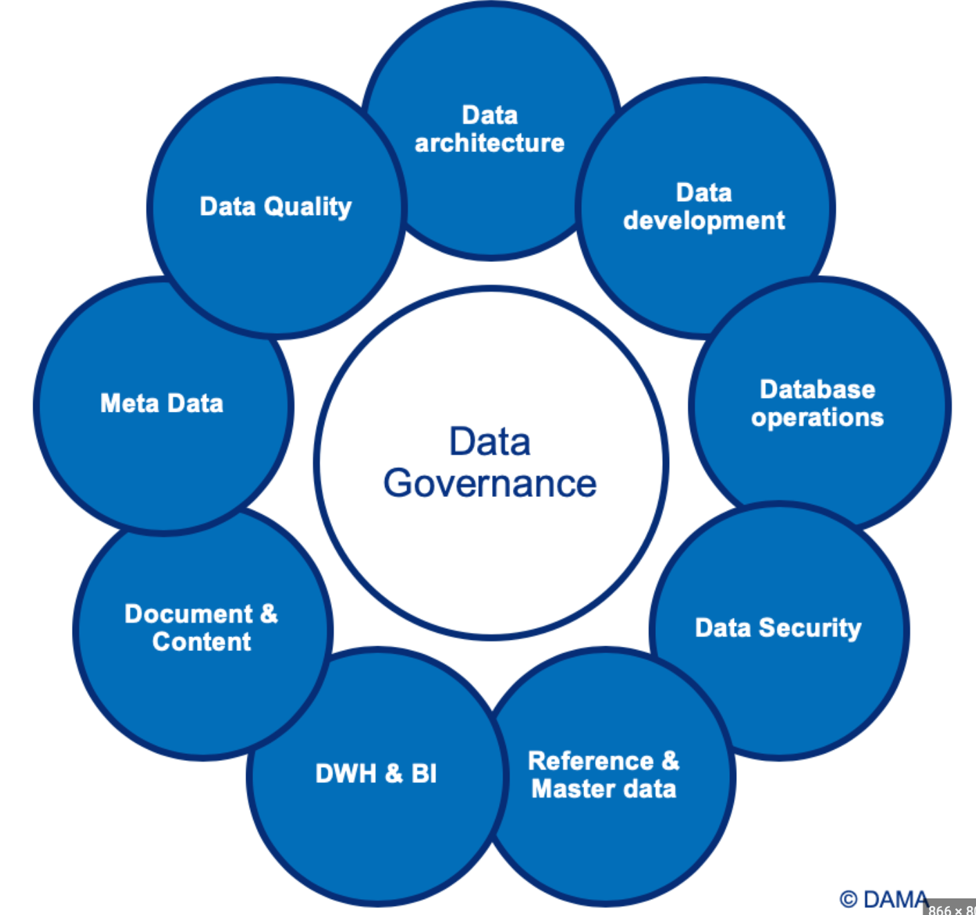
Data Governance
Data Governance is a framework for managing the use, storage, and access of data within an organization. It is used to ensure that data is secure, accurate, and compliant with industry regulations and internal policies. Data Governance is also used to ensure that data is being used ethically and responsibly.
Understanding the Basics

